Slide 1




Applied Longitudinal Data Analysis Using R.
Keith Lohse, PhD
Department of Health, Kinesiology, & Recreation
Department of Physical Therapy and Athletic Training
University of Utah

Slide 2

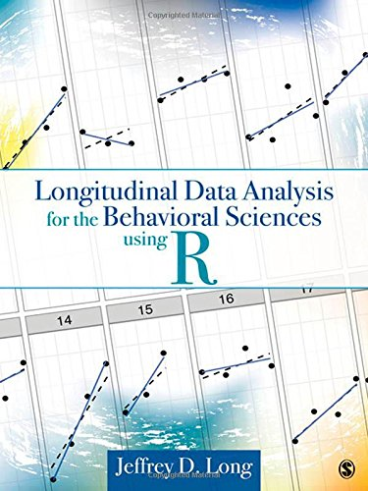
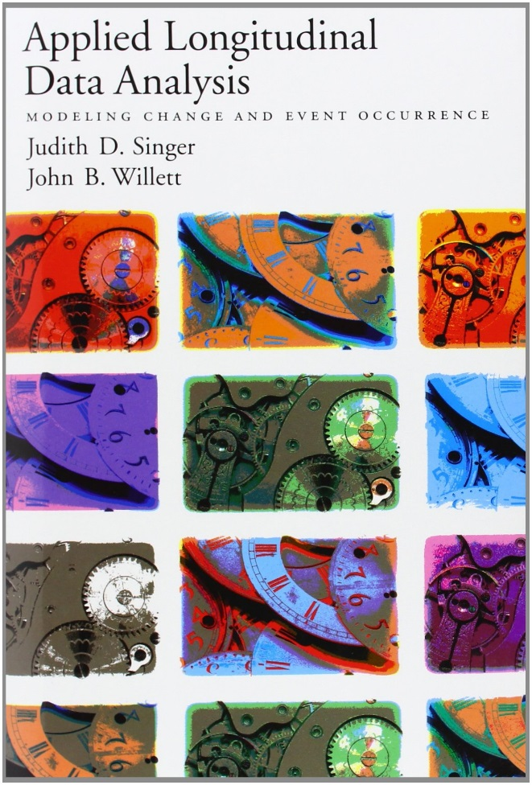


Resources:
We will be using:
R and R Studio
Packages:
lme4
ggplot
dplyr
But you can also use:
Most of what I will say has been said better in these resources!

Slide 3
Roadmap.
Opening R and Troubleshooting.
Data Visualization.
Break and questions.
Model Building
Fixed-Effects, Random-Effects, and Random-Error.
Model Comparison.
Fit statistics: AIC, BIC, and the log-likelihood test.
Break and questions.
Tips, tricks, and asking the right questions.
Phrasing your hypotheses, understanding common terms.
Preparing to meet with a statistical consultant.
Conclusions and questions.

Slide 4
Data Visualization.

Slide 5
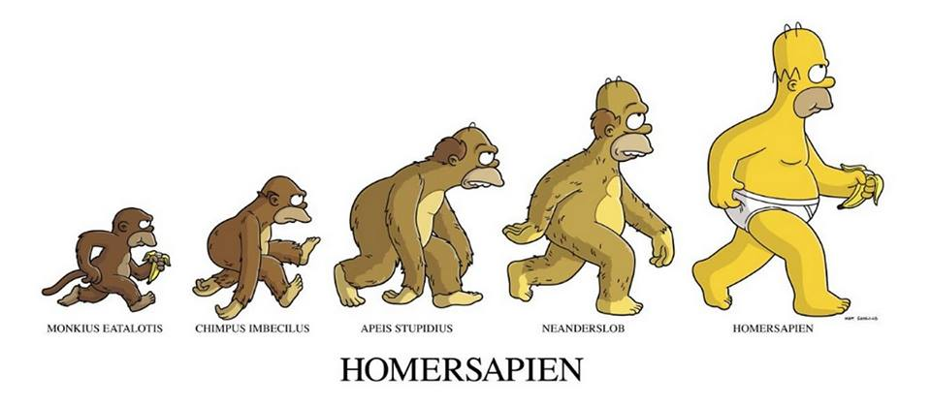
What are longitudinal data?
Multiple observations from individuals over time.
Time nested within people, people nested within classrooms, classrooms nested with schools… etc.
[Matt Groening, The Simpsons]
Observations from proximal time-points are more similar to each other than distal time points. (Auto-regressive correlation structure.)

Slide 6
Data structures.
Wide (“person”) Format:
Each person is on a row. Repeated observations in columns.
Long (“person-period”) Format
Each variable is a column. There are multiple rows for each person at each time point.
Most LMER packages require long format data.
Even SPSS (although SPSS requires the wide format for RM ANOVA).
Thus, we need organizational tools to convert between the two.

Slide 7
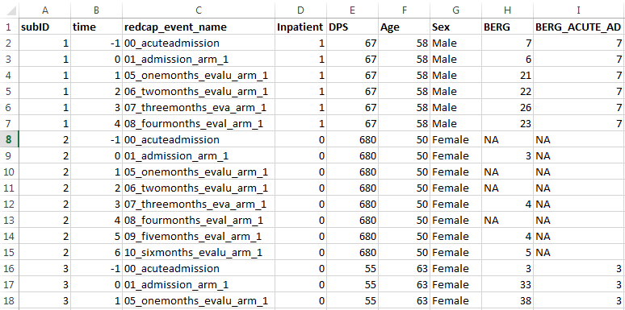
Data structures.
Sub #2 has 4/7 time points for the BERG.
In traditional RM ANOVA, we would need to remove this participant entirely!!!

Slide 8
Data structures.
Dynamic variables vary within a subject.
Static variables vary between subjects.

Slide 9
Data structures.
Repeated Measures AN(C)OVA
Linear Mixed-Effect Regression (LMER)
Participants with different numbers of observations?
Remove participants with missing cases entirely.
Not a problem.
The “within” variable is continuous?
Designed to deal with categorical “factors”.
Not a problem.
Homogeneity of regression slopes?
The coviarate must be independent of the groups.
Not a problem.
Most people are familiar with how it works?
Yes, it makes them feel comfortable and safe.
No, the statistical tools required are more recent, more complex, and currently less commonly used in many fields of research.

Slide 10
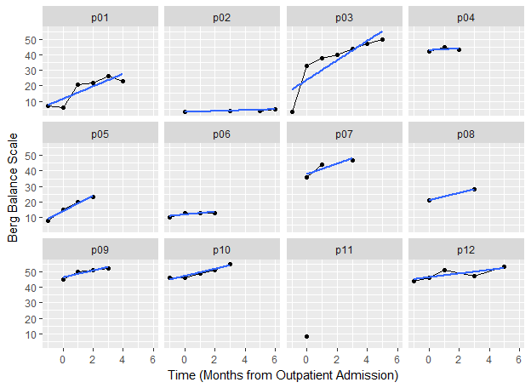
Data visualization.
How much usable data do we have for each participant?
Does the growth look linear or non-linear?

Slide 11
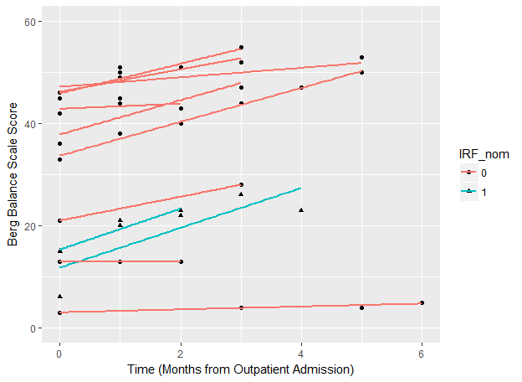
Data visualization.
We can also look at the data conditional on other factors. For instance, are there group differences between participants on average?
Are there group differences in the trajectories of our different participants?

Slide 12
Roadmap.
Opening R and Troubleshooting.
Data Visualization.
Break and questions.
Model Building
Fixed-Effects, Random-Effects, and Random-Error.
Model Comparison.
Fit statistics: AIC, BIC, and the log-likelihood test.
Break and questions.
Tips, tricks, and asking the right questions.
Phrasing your hypotheses, understanding common terms.
Preparing to meet with a statistical consultant.
Conclusions and questions.

Slide 13
Model Building

Slide 14
Understanding linear mixed-effect regression (LMER)
A generalized linear model for hierarchical linear modeling and multi-level modeling. (Raudenbush & Bryk, 2002)
Time is a predictor.
Can equally be applied to survival analysis or event history analysis. (Cox & Oakes, 1984)
Time is an outcome.

Slide 15
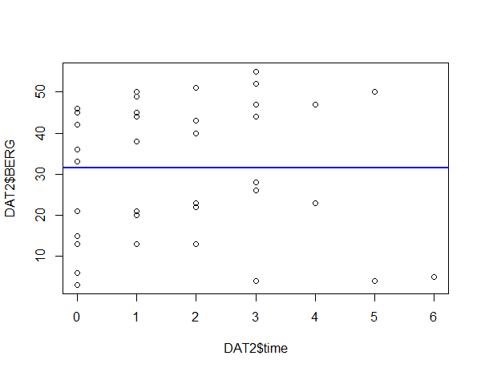

LMER versus classic Regression
Traditional Linear Model
$$y_{i}=β_{0}+β_{1}\left({Time}_{i}\right)+ε_{i}$$
The estimated slope is slightly negative, β = -0.1, and not statistically significant, p = 0.99.
This is clearly the wrong thing to do because this model ignores the fact that time points are nested within particular subjects.

Slide 16
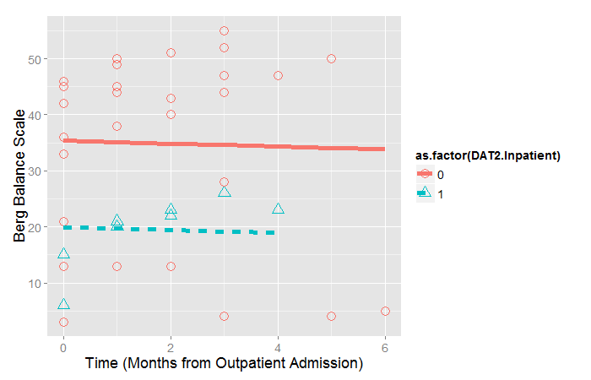

LMER versus classic Regression
Traditional Linear Model
$$y_{i}=β_{0}+β_{1}\left({Time}_{i}\right)+β_{2}({IRF}_{i})+ε_{i}$$
The estimated slope is slightly negative, β = -0.25, and people who went to IRF do worse on average, β = -15.46
This is still the wrong thing to do because this model ignores the fact that time points are nested within particular subjects, even though it accounts for variation between subjects.

Slide 17
Understanding LMER
Compressing our multi-level model to a single equation:
$y_{ij}= β_{0}+β_{1}\left({Time}_{ij}\right)+\left(u_{0i}+u_{1i}\left({Time}_{ij}\right)+ε_{ij}\right)$
Fixed Effects
Random Effects
Random Errors
For applied research, we are mostly going to be interested in the fixed-effects
What is the average rate of change?
Does initial status depend on Variable X?
But in the model building stage, we do have control over our random-effects as well.
Do we need to model different intercepts for each individual?
Do we need to model different slopes for each individual?
And we do need to worry about the relations between our random effects and between the random effects and random errors.
Are lower intercepts correlated with steeper slopes?
Are our random errors (approximately) normally distributed?

Slide 18



“Partitioning” our variance in LMER
6
Person 2
Level 1 (Participant Level)
$$y_{i}=β_{0}^{∗}+β_{1}^{∗}\left({Time}_{i}\right)+ε_{i}$$
5
4
Group Trajectory
Level 2(Group Level)
Person 1
$$β_{0j}^{∗}=β_{0}+u_{0j}$$
Clinical Assessment (Score)
3
$$β_{1j}^{∗}=β_{1}+u_{1j}$$
2
Individual variation
1
0
0
2
4
6
8
10
12
Time in Outpatient Therapy (months)

Slide 19



“Partitioning” our variance in LMER
Did not go to IRF
(lower initial severity)
Level 1 (Participant Level)
6
$$y_{i}=β_{0}^{∗}+β_{1}^{∗}\left({Time}_{i}\right)+ε_{i}$$
5
Level 2(Group Level)
4
$$β_{0j}^{∗}=β_{0}+β_{2}\left({IRF}_{i}\right)+u_{0j}$$
Clinical Assessment (Score)
$$β_{1j}^{∗}=β_{1}+{β_{3}\left({IRF}_{i}\right)+u}_{1j}$$
3
2
Fixed-Effects:
1. Average intercept/slope
2. Effect of ‘X’ on intercept/slope
1
Went to IRF
(higher initial severity)
0
Random-Effects:
3. Participant deviations from group intercept/slope (mean and variance).
4. Correlation between deviations.
0
2
4
6
8
10
12
Time in Outpatient Therapy (months)

Slide 20
Two default models that we will use a lot.
The Random Intercepts model.
Estimate a constant (flat line) for each participant.
The Random Slopes model.
Estimate a trajectory (sloped line) for each participant.
These are the “starter” models that we will use in most of our model building.
Essentially the Random Slopes model is the “model to beat” in evaluating our subsequent fixed-effects.

Slide 21
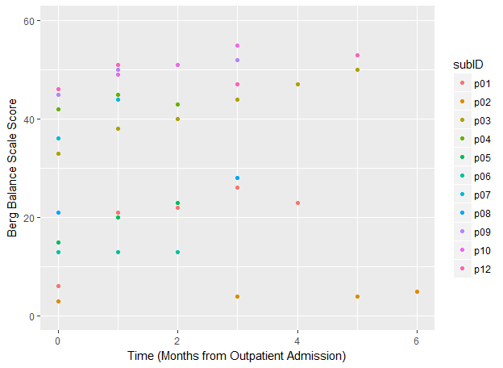



Random Intercepts Models
Overall Model:
$$y_{ij}=β_{0}+u_{0j}+ε_{ij}$$
Level 1 (Participant Level):
$$y_{i}=β_{0}^{∗}+ε_{i}$$
Level 2 (Group Level):
$$β_{0j}^{∗}=β_{0}+u_{0j}$$

Slide 22
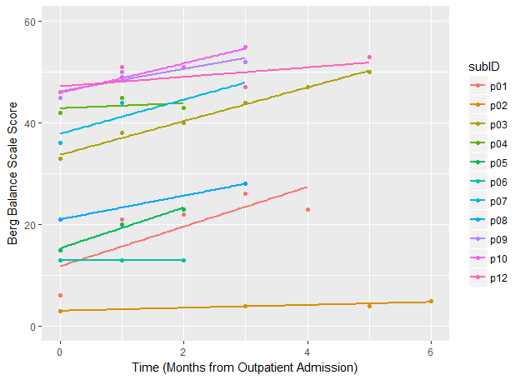



Random Slopes Model
Overall Model:
$$y_{ij}=β_{0}+u_{0j}+ε_{ij}$$
Level 1 (Participant Level):
$$y_{i}=β_{0}^{∗}+β_{1}^{∗}\left({Time}_{i}\right)+ε_{i}$$
Level 2 (Group Level):
$$β_{0j}^{∗}=β_{0}+u_{0j}$$
$$β_{1j}^{∗}=β_{1}+u_{1j}$$

Slide 23
Model Comparisons

Slide 24
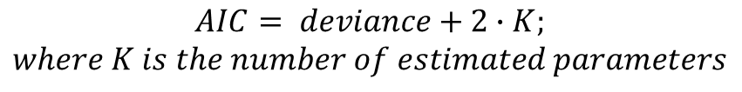
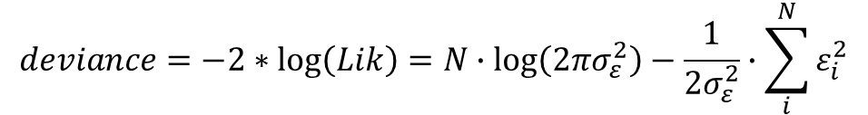
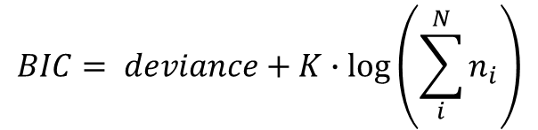
How to decide which model is the best explanation of the data?
$$deviance=−2∗\log\left(Lik\right)=N∙\log\left(2πσ_{ε}^{2}\right)−\frac{1}{2σ_{ε}^{2}}∙\sum_{i}^{N}{ε_{i}^{2}}$$
Deviance
Larger sample size means bigger deviance.
Larger error means bigger deviance.
Thus, for a constant sample size, smaller deviance means better fit.
Akaike Information Criterion (AIC)
Bayesian Information Criterion (BIC)
$$AIC= deviance+2∙K;$$
$$where K is the number of estimated parameters$$
$$BIC= deviance+K∙\log\left(\sum_{i}^{N}{n_{i}}\right)$$

Slide 25
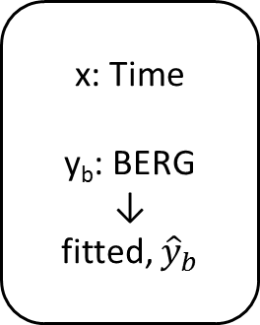
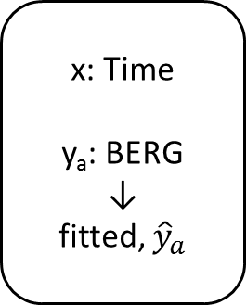

The AIC: The best measure of “predictive” deviance.
Population of Interest
Sample A
Sample B
Sample C
x: Time
y_{a}: BERG
↓
fitted, ${\hat{y}}_{a}$
x: Time
y_{b}: BERG
↓
fitted, ${\hat{y}}_{b}$
x: Time
y_{c}: BERG
↓
fitted, ${\hat{y}}_{c}$
deviance
Predictive
deviance
[Long, 2012]

Slide 26
The AIC: The best measure of “predictive” deviance.
For a given sample, the most complex model is always going to lead to the smallest deviance.
More complex models explain more error even by chance.
The AIC imposes a penalty for additional parameters and the AIC is an unbiased estimate of the long run predictive deviation.
That is, your model with smallest AIC is most likely to be the model with the smallest AIC for a different researcher testing a different sample from the same population.

Slide 27
The model comparison approach.
Are all models based on the same amount of data?
Deviance increases with additional observations. Data pools must be the same size.
How many parameters are being tested?
We want to avoid “over-fitting”, so it is good to look for the model with the lowest AIC/BIC.
How big is the sample size?
The BIC can be overly conservative with large sample sizes.
I would recommend the AIC as it is an unbiased estimate of the predictive deviance.

Slide 28
Roadmap.
Opening R and Troubleshooting.
Data Visualization.
Break and questions.
Model Building
Fixed-Effects, Random-Effects, and Random-Error.
Model Comparison.
Fit statistics: AIC, BIC, and the log-likelihood test.
Break and questions.
Tips, tricks, and asking the right questions.
Phrasing your hypotheses, understanding common terms.
Preparing to meet with a statistical consultant.
Conclusions and questions.

Slide 29
Tips, tricks, and asking the right questions.

Slide 30


Tips, tricks, and FAQs for getting started in longitudinal data analysis.
Keith Lohse, PhD
Department of Health, Kinesiology, & Recreation
Department of Physical Therapy and Athletic Training
University of Utah
rehabinformatics@gmail.com
Allan J. Kozlowski, PhD
Director of Outcomes Research, Mary Free Bed Rehabilitation Hospital
Department of Epidemiology and Biostatistics, Michigan State University College of Human Medicine
allan.kozlowski@maryfreebed.com

Slide 31
1. Know your types of variables.
Static/ “Fixed” variables are variables that keep the same value over the course of the study.
For most longitudinal studies, these are variable that vary between people but stay constant within a person (e.g., gender and age at start of study are example static variables).
Can be continuous or categorical.
Dynamic/ “Time Varying” variables are variables that change value over the course of the study.
Our principle dynamic independent variable is Time (but this could be seconds, months, or years, depending on the resolution over your data).
Most of our dependent variables are also dynamic (i.e., we might have BBS, WMFT, or 10m WT scores at each time point).
Can be continuous or categorical.

Slide 32
2. How will you model time?
Do most people tend to change linearly or non-linearly?
Is there a between-subjects variable associated with different change curves?
Exploratory data visualization I really helpful here and can inform subsequent model building.
Remember that the more complicated your hypotheses about time, the more time-points you will need to collect.

Slide 33
3. What does zero mean in your model?
Continuous Variables
Do you have an interpretable zero in your independent variables:
Age versus Onset days (Age = 0 doesn’t make sense; Onset = 0 might).
Have you mean-centered the variables in your model?
If all variables are mean-centered, you can interpret the effects of one variable “on average” across the other variables.
Is there a separate value you want to center your variables on?
I.e., look at group differences at the end rather than beginning by making the terminal point the intercept.
Categorical variables:
Contrast coded versus dummy coded variables.
Contrast codes make zero the average, dummy codes make the reference group zero.

Slide 34
4. Levels of measurement
Do you really have an interval level variable?
The errors that result from treating non-interval data as interval data actually get worse across time (e.g. FIM scores).
Especially anytime you break a scale into subscales!
Unequal differences in scale warp the shape of the time function.
Look into Rasch Scaling as an approach to “intervalizing” ordinal data.
Pragmatically, check your residuals and the assumptions of the MLM.

Slide 35
5. What effects are you interested in?
Main Effect of Time
Time by Gender Interaction
Time by Age Interaction
Person Level
Gender
Age
Time Level
Linear Effect
of Time
Often, we are interested in interactions between the person-level and the time-level, but we can also test main-effects and interactions within the person-level or within the time-level!

Slide 36
6. How do I compare between models?
Models can have different methods of estimation in order to fit their parameters:
ML – maximum likelihood estimation.
REML – restricted maximum likelihood estimation.
Often we prefer ML to REML because it allows us to compare nested models using likelihood based methods like the change in deviance or the Akaike Information Criterion (AIC).
Deviance is a measure of the amount of error in a model, so lower deviance means a better model.
This can be tested statistically with the Wald Test of the change in deviance.
AIC is also a measure of error in a model, so lower AIC means a better model.
However, the AIC also introduces a penalty for the number of parameters in a model. This makes the AIC more conservative and helps prevent “over-fitting” of the model.

Slide 37
7. How do I statistically power a longitudinal study?
Statistical power for multi-level models gets pretty complicated, so it is highly recommended that you talk to a statistical consultant. In preparation for that meeting, you’ll want to be able to phrase your main narrative hypothesis as a statistical hypothesis like the following:
“I am interested in the main-effect of time.”
You will need to estimate how much you expect participants to change over time, estimate the average standard deviation at each time point, and the average correlation between time points.
“I am interested in the interaction of time and group.”
You will need to estimate all of the same information as above, but you will need to estimate it for each group.
As a rule of thumb, increasing the number of time-points will improve power for effects at the time-level and person by time interactions.
Increasing the number of participants will improve power for effects at the person-level and person by time interactions.

Slide 38
8. What if I have multiple levels?
Multi-level models can do that!
Let’s say that you are running large international study…
Or combining data from lot’s of different studies in secondary analysis…
Country Level
London
Paris
Atlanta
Clinic Level
C1
C2
C3
C4
…
…
Person Level
P1
P2
P3
P4
…
…
Time Level
T1
T2
T3
T4

Slide 39
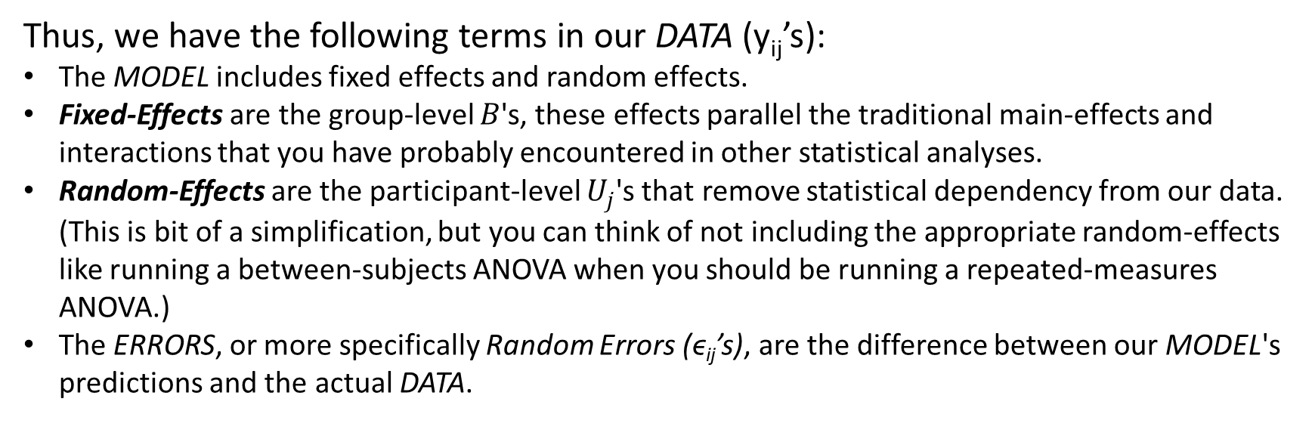
9. What are Fixed-Effects and Random-Effects?
Remember the general concept of DATA = MODEL + Error.
This can be more elaborately written as:
$$y_{ij}=B_{0}+U_{0j}+(B_{1}+U_{1j})∗(TIME_{ij})+ε_{ij}$$
Thus, we have the following terms in our DATA (y_{ij}’s):
The MODEL includes fixed effects and random effects.
Fixed-Effects are the group-level $B$'s, these effects parallel the traditional main-effects and interactions that you have probably encountered in other statistical analyses.
Random-Effects are the participant-level $U_{j}$'s that remove statistical dependency from our data. (This is bit of a simplification, but you can think of not including the appropriate random-effects like running a between-subjects ANOVA when you should be running a repeated-measures ANOVA.)
The ERRORS, or more specifically Random Errors (ϵ_{ij}’s), are the difference between our MODEL's predictions and the actual DATA.

Slide 40
10. Assumptions
Normality
Does transforming the DV change the model?
Make it clear to readers that you tested transformed and raw DVs.
Homoscedasticity
Scale Invariance
Is there bias in the models predictions?
Explore methods for looking at measurement variance over time.
Influential data points/sources
There are tools for checking Cook’s Distances and VIFs in MLMs.
Influential data don’t always show up in univariate plots/analyses.
See philosophical discussions about outliers and removing influential data points.
Run the model both ways and be transparent about what you did in your write-up.
Floor/Ceiling Effects

Slide 41

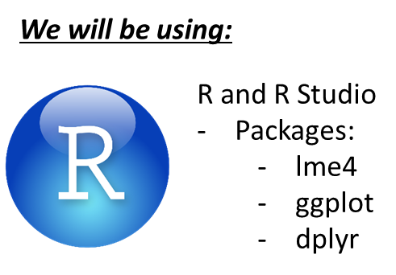

11. How can I actually run my multi-level models?
There are numerous texts to help and software packages to do it. They are all slightly different, but users need the same basic understanding of fixed-effects and random-effects to make sure models run correctly.
But you can also use:
Most of what I will say has been said better in these resources!

Slide 42
12. Be up front about your limitations.
Exploratory modelling.
You will test a lot of things you probably didn’t plan on testing, but be transparent in the reporting of your analyses.
The dataset that generates a model/prediction cannot also be used to confirm that model/prediction.
Are your results “robust” to the method of analysis?
A lot of issues about how you are modelling times, do you meet normality, or should exclude an influential data point can be addressed by running the model both ways.
Is the answer the same both time? Is a difference in the answer meaningful?

Slide 43
Thank you very much!
If you have any questions regarding this talk or the LMER code in the accompanying script file, please email me:
rehabinformatics@gmail.com

